Slide 1
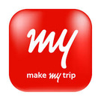

WIPRO CAPSTONE PROJECT
Automation Testing Project
Make My Trip Booking
Domain Name: Booking System

Slide 2
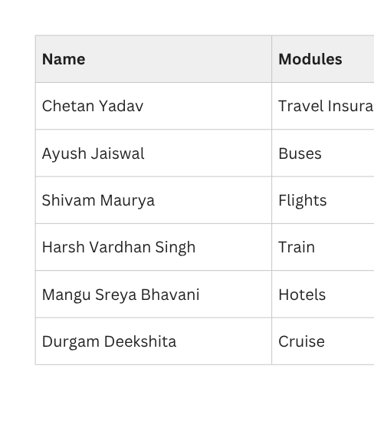

Slide 3
Module Name: Travel Insurance
Objective-This capstone project aims to build a scalable BDD automation framework using Selenium and Cucumber to validate end-to-end travel booking workflows. Key objectives include writing human-readable Gherkin feature files, implementing a reusable Page Object Model, handling complex dynamic elements, and generating detailed execution reports with failure screenshots.
Flow of End to End
Positive Test Scenarios
Open the MakeMyTrip website.
Close the initial login popup.
Open the travel insurance page.
Input data for destination and number of travelers, then click on explore.
Choose a plan.
Fill details like name, date of birth, email, mobile number, and gender.
Click on the buy button.
When the login popup opens, enter your mobile number, click the checkbox, and hit the continue button.
Check for International Travel + Medical Insurance & Assistance
Check for Choose plan for your Trip
Check Traveller Details
Check for Form filled
Negative Test Scenarios
Check error for blank DOB
Check error for blank mobile number
Check error for wrong mobile number

Slide 4
Module Name: Buses
Objective: Develop an automation testing framework for the MakeMyTrip Buses module using Selenium WebDriver with Pytest and BDD Behave frameworks to validate bus search, route verification, filter handling, seat selection, booking validation, and payment navigation with Data-Driven Testing, Allure Reporting, logging, and screenshot capturing.
Flow of End to End
Positive Test Scenarios
Launch MakeMyTrip application
Close login popup
Navigate to Buses module
Enter source and destination city
Select journey date and search buses
Apply AC filter
Select available bus and seat
Verify boarding and dropping points
Enter passenger details
Proceed to payment page
Enter card details
Close the browser
Route Validation
Sleeper Filter Validation
Seat Selection Verification
Booking Page Route Validation
Negative Test Scenarios
Same Source and Destination Validation
No Buses Found Validation

Slide 5
Module Name: Flights
Objective: Automate and validate the end-to-end booking workflow for the Flights module on MakeMyTrip using Selenium + Pytest and BDD + Behave frameworks. The framework verifies search workflows, booking flow validations, filtering capabilities, passenger restrictions, and responsive interactions across multiple scenarios.
Flow of End to End
Positive Test Scenarios
Launch MakeMyTrip application
Handle overlay modal
Navigate to Flights module
Select trip type (One Way)
Enter source and destination cities
Select departure date
Execute flight search
Open fare details, “View Prices”
Proceed with “Book Now” flow
Validate booking page redirection
Add passenger details
Enter contact information
Validate required field behavior
Confirm booking.
One-Way Flight Search Validation
Dynamic City Selection
Non-Stop Flight Filter Validation
Airline Filter Verification (Example: Air India)
Negative Test Scenarios
Infant Restriction Validation
[Verify error when number of
infants exceeds adults.]
Same Source and Destination
[Verify error when same city
are selected.]

Slide 6
Module Name: Trains
Objective: The main goal of this project was to make sure the entire train ticket booking process works perfectly from start to finish. To achieve this, I wrote an automated script that acts like a real user. It automatically searches for train routes, picks an available seat, and fills in all the passenger details using information saved in Excel files. Finally, the script double-checks that the website safely makes it to the final payment page without freezing or showing any errors.
Flow of End to End
Positive Test Scenarios
Launch MakeMyTrip application
Close login popup
Navigate to Trains module
Enter source and destination stations
Select travel date and search trains
Apply AC and Available filters
Select available train ticket
Open add traveller modal and enter passenger details
Enter IRCTC username and contact details
Accept terms and proceed to payment
Select credit card option and enter details
Close the browser
Valid Source & Destination Search
Train Listing & Availability Validation
AC and Available Filter Validation
Payment Page Navigation Validation
Negative Test Scenarios
Invalid Source and Valid Destination Search
Invalid Mobile Number Validation

Slide 7
Module Name: Hotels
Objective:The Hotel Module Automation Framework validates the complete hotel booking process of MakeMyTrip using Selenium with Python. It automates hotel search, guest details entry, hotel selection, and checkout validation. The framework uses POM architecture, Pytest execution, and CSV-based data-driven testing for multiple scenarios.
Flow of End to End
Positive Test Scenarios
Launch MakeMyTrip application
Handle Login popup
Navigate to Hotel module
Enter Destination or City
Enter Stay dates
Add Rooms & Guests
Click on Search Parameter
Apply 5-Star Filter
Selects First Hotel From Hotel Listings
Clicks On Book This Now
Add Guest Details
Selects Secure Trip Option
Click On Pay Now
Guest Details Validation From Csv Data
Dynamic City Selection
Entering Correct Pan-Number
Applying 5-Star Filter
Negative Test Scenarios
Invalid PAN Card Format Validation
Empty First Name

Slide 8
Module Name: Cruise
Objective: Streamline and verify the complete cruise booking journey and cross-domain transitions to mmt.odysol.com by deploying a Selenium and BDD-based automation framework.
Flow of End to End
Test Summary
Launches the Make My Trip Website
Intermittent Modal Handling
Entering cruise tab
Search Parameter Injection
Cross-Domain Handshake
Filter Verification and selects the first cruise
Cabin Selection
Guaranteed Booking page
Passenger Matrix Processing
Contact Details and Dining options
Injection of PAN ID and proceed
Checkout page with price details
Teardown & Artifact Capture
Positive Test Scenarios
Integration Flow (E2E)
Lowercase PAN ID Auto-Sanitization
Dynamic Sorting & Selection by Departure Date
Financial Price Validation
UI Responsiveness & Window Switching
Negative Test Scenarios
Invalid PAN Card Format Validation
Required Field Validation (First Name Omitted)

Slide 9
DELIVERABLES
1. AUTOMATION FRAMEWORK
Selenium WebDriver + PyTest + Behave BDD with Page Object Model (POM) architecture.
2. TEST COVERAGE
End-to-End, Positive & Negative test cases across all team modules .
3. ALLURE REPORTS
Professional HTML reports with step-by-step execution flow, screenshots & history.
4. SCREENSHOT EVIDENCE
Automated screenshot capture at each key execution stage for audit & debugging.
5. EXECUTION LOGS
Detailed Python logging for execution tracking and failure diagnosis, the log reports were made.
6. GITHUB REPOSITORY
Full codebase with README, feature files, page objects, and data files version- controlled.

Slide 10
THANK YOU

